Slide 1
Serverless Computing & StartNIC
李涛
2021.12.6

Slide 2
Part Ⅰ: Serverless Computing Applications and Characteristics

Slide 3
Serverless Computing
存储计算分离
Serverless = FaaS + BaaS ^{[1]}
Serverless
sandbox
object storage
request
stateless
function
data、state....
KV database
.....
FaaS
BaaS
Serverless computing model
[1] Cloud Programming Simplified: A Berkeley View onServerless Computing

Slide 4
Stateless vs Stateful Serverless
Stateless Serverless
状态不存在server，放在client或者database
request复杂，request之间相互独立
Stateful Serverless
状态放在server
request简单，request之间有所依赖
Notes:
- stateless
- 不是说一定没有状态，而是采用的极端的存储计算分离的方案，状态不放在server端
- 因为server端没有之前到达request的历史信息和状态，request之间相互独立，因此request相对比较复杂，必须包含所有必须的信息，使得server端理解需求
- stateful
- 状态放在server端
- 因为可以利用储存的之前的request的历史数据和状态，request可以相对简单

Slide 5
An Instance: Square(Increment(int: x))
Stateless Serverless
request₁
DB
Increment()
Stage 1
request₂
Square()
Client
FaaS
BaaS
Notes:
- 以一个复合函数square(increment(x))展示stateless和stateful各自的优缺点

Slide 6
An Instance: Square(Increment(int: x))
Stateless Serverless
request₁
Stage 2
DB
Increment()
Stage 1
int: x+1
request₂
Square()
Client
FaaS
BaaS
Notes:
- 以一个复合函数square(increment(x))展示stateless和stateful各自的优缺点

Slide 7
An Instance: Square(Increment(int: x))
Stateless Serverless
request₁
Stage 2
DB
Increment()
Stage 1
int: x+1
request₂
Square()
Stage 3
Client
FaaS
BaaS
Notes:
- 以一个复合函数square(increment(x))展示stateless和stateful各自的优缺点

Slide 8
An Instance: Square(Increment(int: x))
Stateless Serverless
request₁
Stage 2
DB
Increment()
Stage 1
int: x+1
request₂
int: (x+1)²
Square()
Stage 3
Client
Stage 4
FaaS
BaaS
Notes:
- 以一个复合函数square(increment(x))展示stateless和stateful各自的优缺点

Slide 9
An Instance: Square(Increment(int: x))
Stateful Serverless
DB
Stage 1
Increment()
request₁
Client
FaaS
BaaS
Notes:
- 以一个复合函数square(increment(x))展示stateless和stateful各自的优缺点

Slide 10
An Instance: Square(Increment(int: x))
Stateful Serverless
DB
Stage 1
Increment()
request₁
int: x+1
Client
Stage 2
FaaS
BaaS
Notes:
- 以一个复合函数square(increment(x))展示stateless和stateful各自的优缺点

Slide 11
An Instance: Square(Increment(int: x))
Stateful Serverless
DB
Stage 3
Square()
request₂
int: x+1
Client
Stage 2
FaaS
BaaS
Notes:
- 以一个复合函数square(increment(x))展示stateless和stateful各自的优缺点

Slide 12
An Instance: Square(Increment(int: x))
Stateful Serverless
DB
Stage 3
request₂
Square()
Stage 4
int: (x+1)²
int: (x+1)²
Client
Stage 2
FaaS
BaaS
Notes:
- 以一个复合函数square(increment(x))展示stateless和stateful各自的优缺点

Slide 13
Stateless vs Stateful Serverless
Stateless Serverless
伸缩性高，水平扩展能力强
时延高
Stateful Serverless
时延低
扩展性差
Tradeoff
Re-architect platform^{[2][3]} : cache、shared logs...
Re-architect application^{[4][5]} : stateless RPC...
[2] Cloudburst: stateful functions-as-a-service VLDB’20
[3] Boki: Stateful Serverless Computing with Shared Logs SOSP’21
[4] Nightcore: Efficient and Scalable Serverless Computing for Latency-Sensitive, Interactive Microservices ASPLOS’21
[5] Lessons Learned from Migrating Complex Stateful Applications onto Serverless Platforms APSys’21
Notes:
- stateless
- stateful

Slide 14
Serverless Applications
Video processing^{[6][7]}
Data analytics^{[8][9]}
Machine learning^{[10][11]}
[6] Sprocket: A Serverless Video Processing Framework SoCC’18
[7] Encoding, Fast and Slow: Low-Latency Video Processing Using Thousands of Tiny Threads NSDI’17
[8] Occupy the Cloud: Distributed Computing for the 99% SoCC’17
[9] Shufing, Fast and Slow: Scalable Analytics on Serverless Infrastructure NSDI’19
[10] Cirrus: A Serverless Framework for Endto-End ML Workﬂows SoCC’19
[11] Faasm: Lightweight Isolation for Efcient Stateful Serverless Computing ATC’20

Slide 15
Serverless Applications
Distributed compilation^{[12]}
Transcational workflows^{[13]}
Interactive microservices^{[4]}
[12] From Laptop to Lambda: Outsourcing Everyday Jobs to Thousands of Transient Functional Containers ATC’19
[13] Fault-tolerant and transactional stateful serverless workflows OSDI’20

Slide 16
Serverless Computing Characteristics
Burst

Slide 17
Serverless Computing Characteristics
Parallel

Slide 18
Serverless Computing Characteristics
Vraying Workload

Slide 19
Part Ⅱ: StartNIC

Slide 20
What ？
Exsiting design
cache-based
customizing sandbox
checkpiont/restore
Catalyzer’s design
on-demand restore
reuse sandbox template

Slide 21
Why ？
缓存函数依赖的热点库 （for App init）
共享包含函数代码及其库的沙箱^{[1]}
缓存预热的Python解释器^{[2]}
问题
内存开销
无法解决尾延迟 （ ？）
沙箱初始化依赖于函数特定的配置
[1] {SOCK}: Rapid Task Provisioning with Serverless-Optimized Containers ATC’18
[2] {SAND}: Towards High-Performance Serverless Computing ATC’18
Notes:
同一个应用程序的函数，共享包含函数代码及其库的沙箱^{[1]}
缓存预热的Python解释器，函数可以使用已经加载必要库的解释器启动^{[2]}
Serverless函数单机整合度高，缓存会带来较大的内存开销
无法解决尾延迟？？

Slide 22
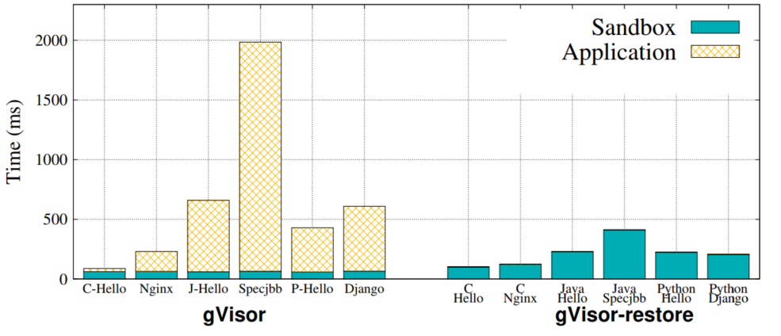
How ？
C/R
将运行中沙箱的状态保存到检查点映像中
application state
sandbox state
沙箱可以从映像中恢复，减轻启动开销
Insight：C/R将应用程序初始化成本转换为沙箱恢复成本(init-less booting)
gVisor和gVisor-restore的启动延迟

